Slide 1

Wireless Mesh Network
The Painless Way!

Slide 2
What is a PainlessMesh!
It’s an open source library specifically written for ESP8266 platforms
It’s painless as it is intended to be auto-configure and easy to setup
All nodes in the network acts as either Access Point (AP) or Station, and nodes are equal
A mesh network is a “Star Network”, but no central access point
Every node is aware of the whole network topology
Every node tells its neighbors about other nodes it is directly or indirectly connected to

Slide 3
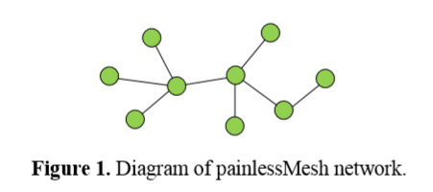
Diagram of a typical PainlessMesh network

Slide 4
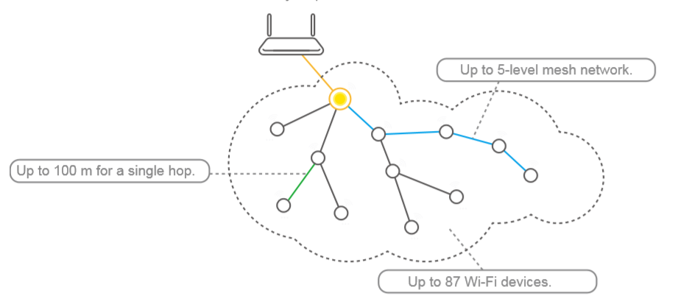
Why Mesh!
The development of the Internet of Things (IoT) requires an increasing number of nodes to connect to the internet. However, only limited number (usually fewer than 32) of nodes can directly connect to the same router.
There are two solutions currently available for this problem Super Routers or Mesh Network

Slide 5
Messages can be ..
Single: Sent to a specific ESP8266 Module (Point-to-Point)
Broadcast: Sent to every node in the network
Nodes can be distinguished by a 32-bit number representing the MAC (Media Access Control) Address of each chip.
Message type used is of JSON (JavaScript Object Notation) format

Slide 6
JSON Format
It uses human-readable text to transmit and receive data (Serializable)
It also uses the form of the value-key pairs (like dictionaries in python)

Slide 7
Model Used

Slide 8
Broadcasting
Every node will broadcast a unique message
When receiving these broadcasts, a specified message will be extracted and used by the receiver
3 Nodes will be used

Slide 9

Hardware

Slide 10
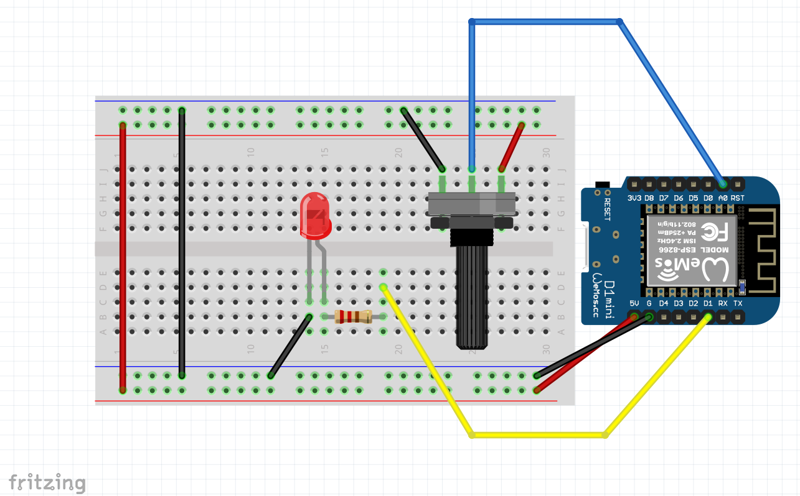
First Node

Slide 11
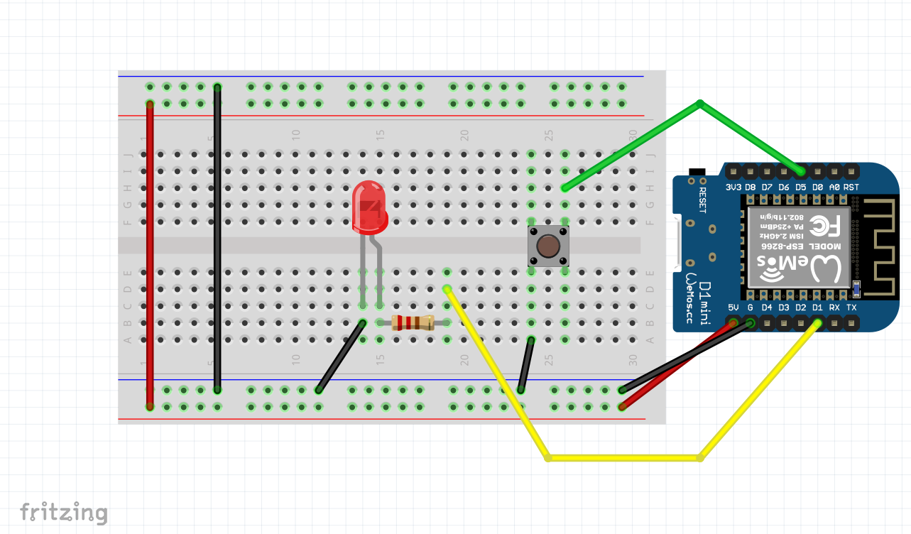
Second Node

Slide 12
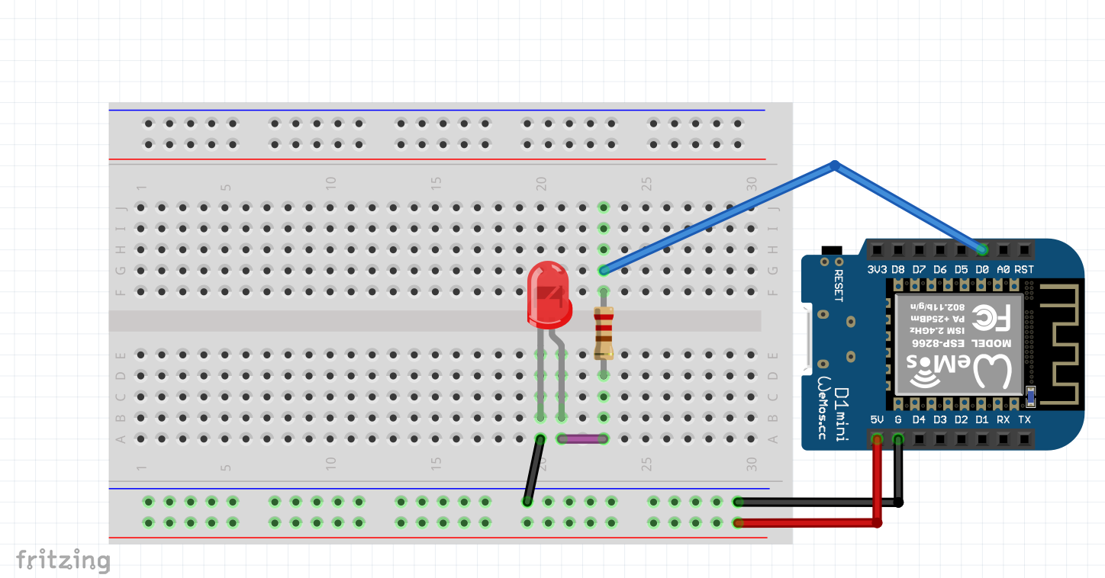
Third Node

Slide 13
Let’s Code

